Slide 1
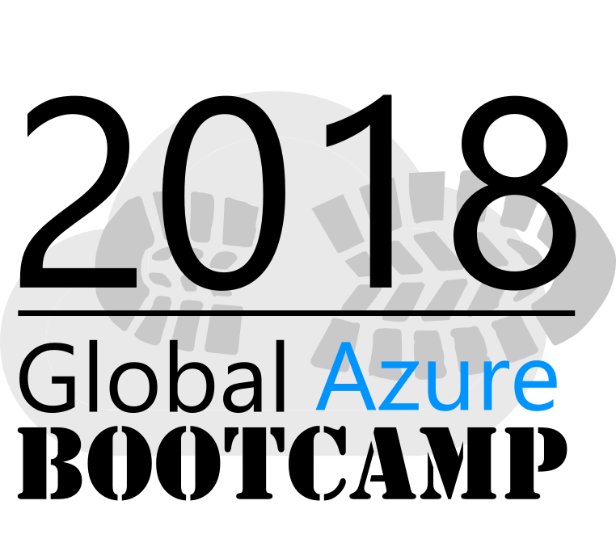
Welcome to the
St. Louis, Missouri
Wifi: STLCC
User: k.grossnicklaus.018
Pwd: AppliedSaurels?

Slide 2
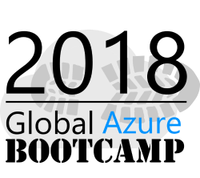







A BIG thank you to the 2018 Global Sponsors!

Slide 3

Another BIG thank you to local sponsor!

Slide 4
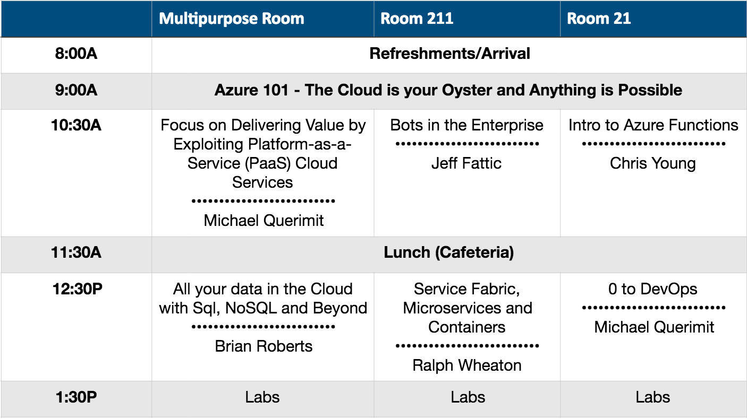
Session Breakouts

Slide 5
Wi-Fi
Please connect to the Wi-Fi network
Wi-Fi SID:
User Name: k.grossnicklaus.018
Password: AppliedSaurels?
You may need to open a browser to connect.

Slide 6
Housekeeping info
Rooms
Refreshments
Lunch
Restrooms

Slide 7
Speakers
Kevin Grossnicklaus, ArchitectNow
Bryan Roberts, Microsoft
Jeff Fattic, Microsoft
Michael Querimit, Microsoft
Chris Young, ArchitectNow
Ralph Wheaton, Daugherty

Slide 8
Technical Requirements?

Slide 9
Azure 101 – What is Azure?
Kevin Grossnicklaus, ArchitectNow
kvgros@architectnow.net
@kvgros

Slide 10
The “Cloud”

Slide 11
Azure is…
A color
A brand
A set of services hosted by Microsoft you can use
A collection of data centers spread throughout the world
A hosting environment you can host your application inside of
A collection of tools and APIs you can utilize from your local or mobile apps
Much more…

Slide 12
Azure 101 - Key Terminology
Azure
"Cloud"
Infrastructure as a Service (IaaS)
Platform as a Service (PaaS)
Software as a Service (SaaS)
Data center
Storage
Processing
Compute
Consumption
Dashboard
Subscription/Tenant
Resource Group
Tag
Instance
DTU (Data Transaction Unit)

Slide 13
Azure Considerations
Performance
Scalability
Reliability
Redundancy
Security
Maintainability

Slide 14
Azure Data Centers

Slide 15
Azure Data Centers
Over 40 data centers
http://map.buildazure.com/

Slide 16
Azure – But what is it?
Infrastructure as a Service (IaaS)
Platform as a Service (PaaS)
Software as a Service (SaaS)

Slide 17
Azure – The “Diagram”

Slide 18
Azure Resources
Key terms:
Resource
Resource Group
Resource Manager

Slide 19
Azure Costs
What will I pay?
Pay for what you use (Consumption of resources)
Prices/Measures/Metrics differ per resource type
How do I pay?
Pay as you Go (Credit Card)
Pay through a Microsoft Partner (CSP)
Custom agreements (Pre-pay, etc)
How can I budget?
Pricing calculator
Integrated billing tools
Set budgets

Slide 20
Azure Service Level Agreements
Differs per resource type
https://azure.microsoft.com/en-us/support/legal/sla/
Example:
VM using premium storage for all OS and data disks:
99.9% SLA guarantee of access to the instance
VMs with two or more instances across Availability Zones in same Region:
99.99% SLA guarantee of access to at least 1 instance

Slide 21
Azure Management
How do I access Azure and manage my resources?
Azure Portal
REST Apis
CLI/Powershell
SDKs
3rd Party Tools
SQL Management Studio

Slide 22
Azure Portal
Portal.Azure.com

Slide 23
Azure CLI
Command line access to Azure
Install on Mac, Windows, or Linux
Example:
Az vm create –n MyLinuxVM –g MyResourceGroup –image UbuntuLTS
Run in your browser:
https://shell.azure.com/

Slide 24
Azure Rest APIs
Manage your Azure resources via code or other tools
https://docs.microsoft.com/en-us/rest/api/
You can…
Discover resources
Create resources
Delete resources
Modify resources
Etc

Slide 25
Azure 3rd Party Tools
SQL Management Studio
Visual Studio
Storage Explorer - https://azure.microsoft.com/en-us/features/storage-explorer/
Cerebrata - https://www.cerebrata.com/
Various Mobile Apps
Many more…

Slide 26
Azure Management Security
Management rights can be granted to:
Admins added directly to subscription
Partners associated with your subscription
Most security managed through Active Directory

Slide 27
Azure Resource Manager
Group Azure Resources Together
“Resource Groups”
As a group you can:
Provision
Deploy
Manage
Secure
Report

Slide 28
Azure 101 - Infastructure
Storage, Virtual Machines, Networking, Active Directory

Slide 29
Azure 101 – Infrastructure as a Service
Servers (Virtual Machines)
Storage (File storage, table storage, queues)
Networking (Firewalls, Security)
Active Directory

Slide 30
Azure Storage
Four key types of storage:
Blob storage
Table storage
Queue storage
File storage
Premium vs. Standard Storage
Hot vs. Cold Storage

Slide 31
Azure Virtual Machines
Virtualized Servers
Windows or Linux
Dozens of configuration options
CPU, Cores, Memory, HD types, etc
Large gallery of pre-configured images
RDP servers
Oracle Servers
Etc
Only pay for what is turned on
When “off” disk images are stored in Azure for later use (you pay for the storage)

Slide 32
Azure Networking
Virtual networks
Virtual NIC cards
Load balancers
Build and monitor secure virtual networks directly in Azure

Slide 33
Azure Active Directory
Full Active Directory services within Azure
Used to secure other assets
Can be synced/replicated to on-prem AD servers

Slide 34
Azure 101 - Platform
Data, Apps, Services, More…

Slide 35
Azure 101 - Platform as a Service
Data
SQL
CosmosDB
MySQL
PostgreSQL
Logic Apps (BizTalk)
App Services
Web App
Functions
Mobile Apps
Redis Cache
Service Fabric
Containers
Scheduler
Audio/Video Streaming
Key Vault
IoT
IoT Hub
Event Hub
Stream Analytics
Notification Hubs
Big Data
Data Lake (Hadoop)
R Server
Analysis Services
Cognitive Services
Vision
Speech
Knowledge
Search
Language
AI
R Server
Machine Learning
Bot Service

Slide 36
Azure SDKs
.NET
NuGet
Node
Java
PHP
Ruby
Etc
Full List: https://azure.microsoft.com/en-us/downloads/

Slide 37
Azure Databases as a Service
Microsoft SQL
MySQL
PostgreSQL
CosmosDB
Data Lake (Hadoop)
Table Storage
DTU (Databaes Transaction Units)
https://docs.microsoft.com/en-us/azure/sql-database/sql-database-what-is-a-dtu

Slide 38
Azure App Services
Web Sites
Cache
Batch Services
Functions
Notification Hubs
API Management
Container Services
Media Services
Hosting of custom code and logic
Any supported language and tech stack
More than just .NET

Slide 39
Azure IoT
Stream Analytics
IoT Hub
Machine Learning
Provision and manage devices
Reliable two-way communication for up to billions of device
Secure

Slide 40
Azure Cognitive Services
A suite of API’s performing various advanced tasks
Speech recognition
Text to speech
Image recognition
Emotion recognition
Facial recognition
Text translation
Bing search as a service
Directory: https://azure.microsoft.com/en-us/services/cognitive-services/directory/

Slide 41
Azure Logic Apps

Slide 42
Azure On-Prem Integration
Integrate between on-premises infrastructure and tools and Azure
Service Bus
AD Replication
File Storage
Etc

Slide 43
Azure Monitoring
Microsoft Operations Management Suite
Application Insights

Slide 44
Azure Monitoring

Slide 45
Application Insights

Slide 46
Azure 101 - Software
Office365, Dynamics, Etc

Slide 47
Azure SaaS Offerings
Office 365
Dynamics
TFS (Visual Studio Online)
Thousands of 3rd Party Apps
You likely aren’t aware Azure is their host

Slide 48
Azure 101 – Additional Thoughts
Kevin’s Azure Common Sense

Slide 49
Kevin’s Azure Common Sense
It’s (likely) going to be much more secure than what you can do yourself
Keep like items in same data center
Enjoy fast connectivity between services
Not all services allow you to specify this so be creative in understanding what is where
Plan for failure
Load balancing and redundancy is easy
Storage is cheap
Azure isn’t magic
Know where your consumption is being used
Watch your invoices
Understand everything in your subscription/tenant
Automate scale up/down
Monitor, react, automate, repeat
Get involved
UG’s
Newlists
Slack channels

Slide 50
Kevin’s Azure Challenge
Think Differently
Forget everything you think you know about what is possible or what the “Cloud” is
Capitalize on Capabilities
Be the company with features or scale that your competitors can’t
Start small (“cheap”) and consume more as you grow more
Be creative!

Slide 51
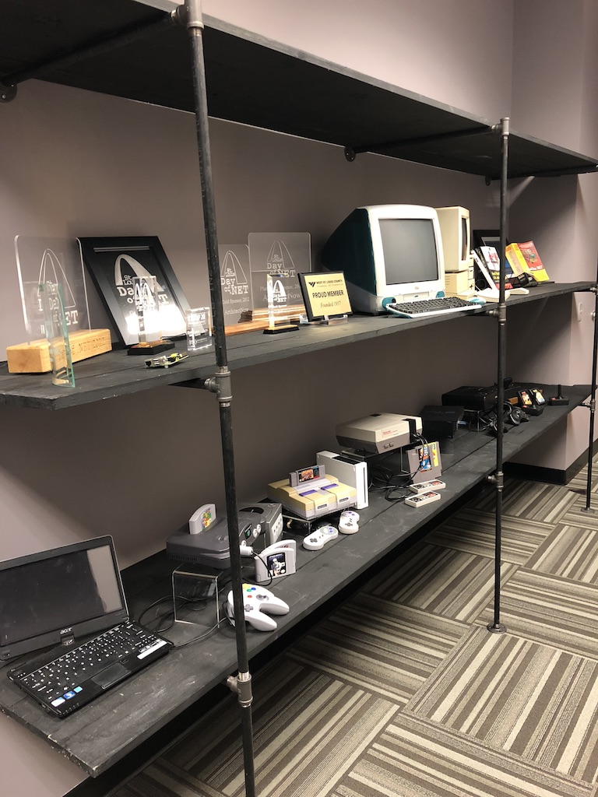
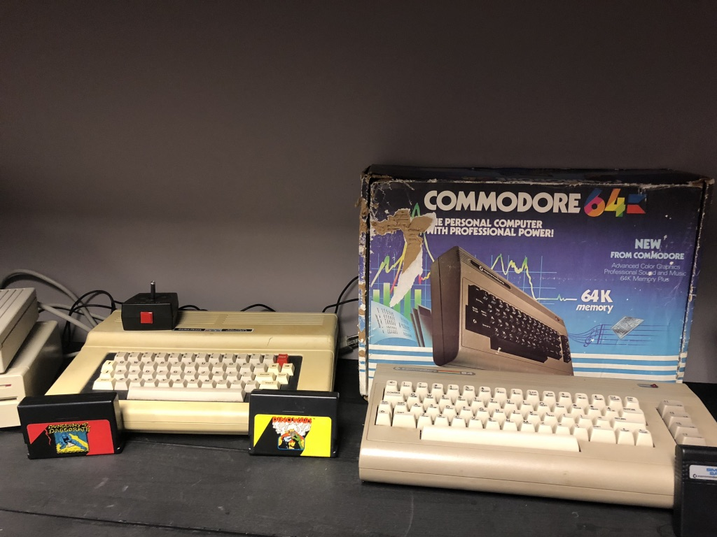
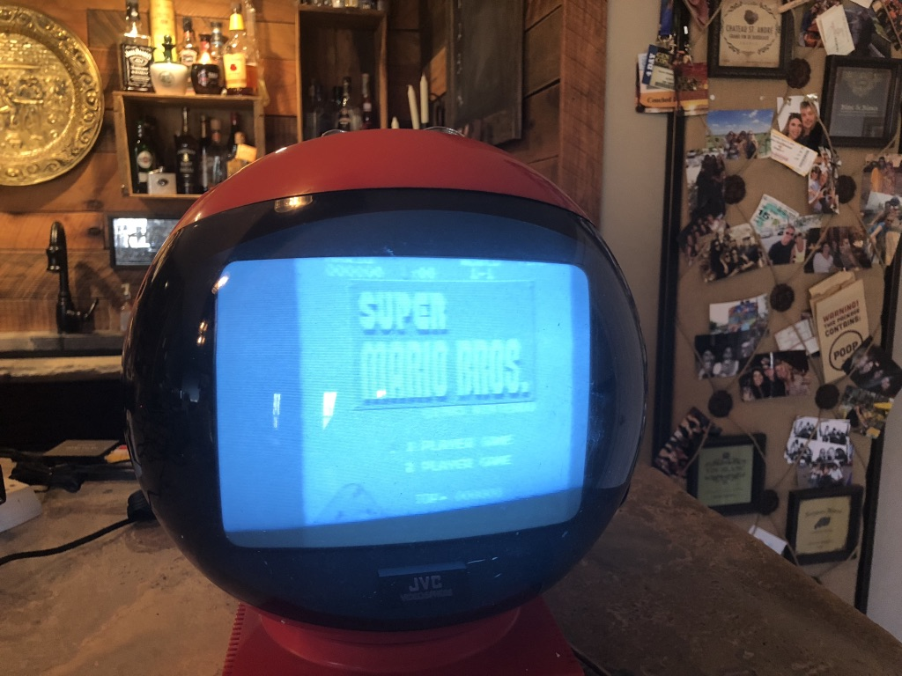
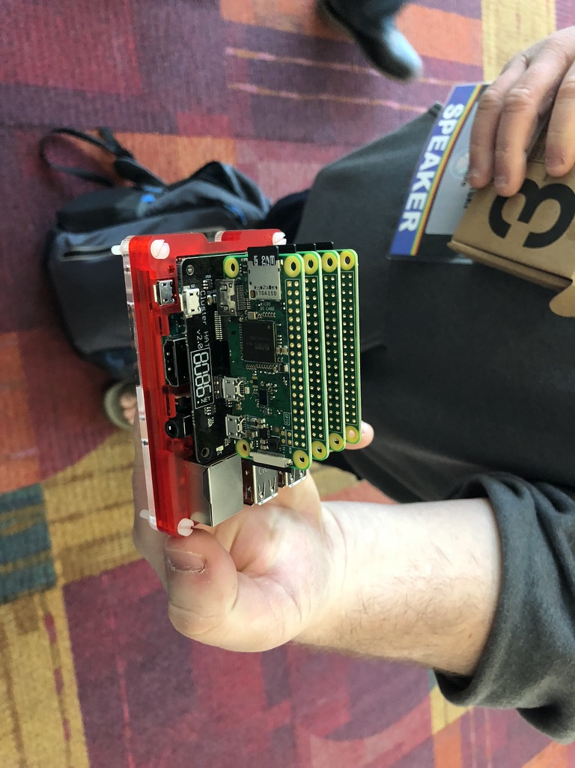
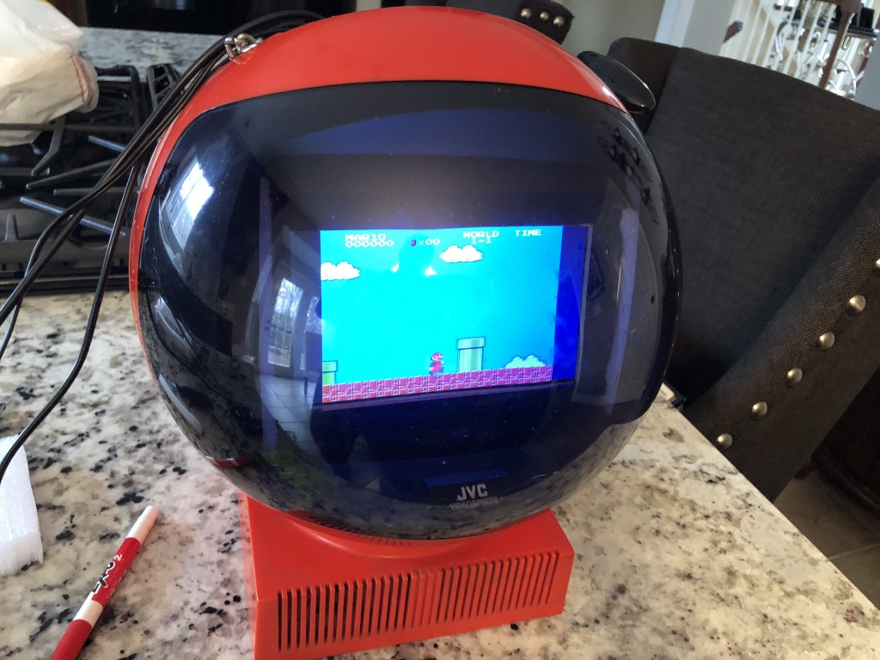
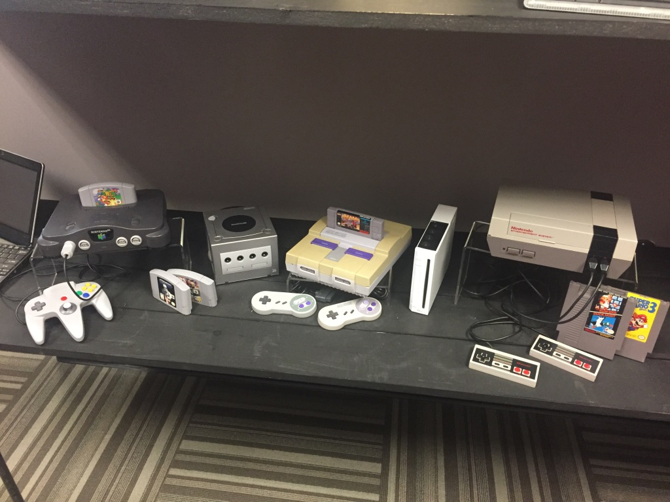
Ready Player One

Slide 52
Thank You and What’s Next?
Kevin Grossnicklaus
kvgros@architectnow.net
@kvgros
www.architectnow.net
Stay Connected!
LinkedIn
Twitter
FB

Slide 53
Global Azure Bootcamp 2018
Continued

Slide 54


All attendees get the following:
Sponsor | Offering
Cloudmonix https://cloudmonix.com | Cloudmonix offers a $300 off any paid plan for Azure monitoring! http://bit.ly/gab2018-cloudmonix Code: GAB2018
MyGet https://myget.org | MyGet offers a free 1 month Starter Plan for hosting your NuGet, npm, Maven, Bower of VSIX feeds! http://bit.ly/gab2018-myget Code: GGAB2018-MG
ServiceBus360 https://servicebus360.com | Servicebus360 is offering 2 months free of their Gold Plan! http://bit.ly/gab2018-sb360
Cerebrata https://cerebrata.com | Cerebrata is providing a 3 month subscription to it’s Cerulean product! Get your subscription key from your organizer!
Offers valid until April 30th

Slide 55


Raffle Prizes
1 Winner: a 1 year personal subscription of the All Products Pack. Get all desktop products including IntelliJ IDEA Ultimate, ReSharper Ultimate and other IDEs
1 Winner: a 1 year subscription to Cerulean! A cross-platform Azure management tool for storage, CosmosDB, Search, Redis Cache and Service Bus.
1 Winner: a 1 year subscription to their online training, Skill Me Up! Online training to continue your Azure journey.
Raffle winners will receive a voucher with a code from the local organizers.

